Slide 1
Modern Programming Languages
UIIT PMAS Arid Agriculture University, Rawalpindi
Course Instructor: Suleman Khurram

Slide 2
What we will learn in this lecture…
Java Statements and expressions
Data types
Variables
Operators and precedence
Coding style

Slide 3
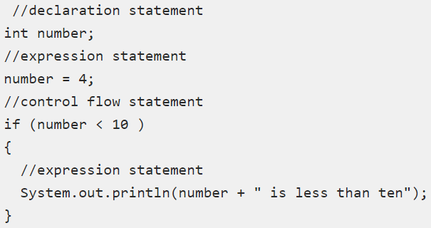
Java Statements
Statements are roughly equivalent to sentences in natural languages. A statement forms a complete unit of execution.
Expression statements change values of variables, call methods, and create objects.
Declaration statements declare variables.
Control-flow statements determine the order that statements are executed.

Slide 4
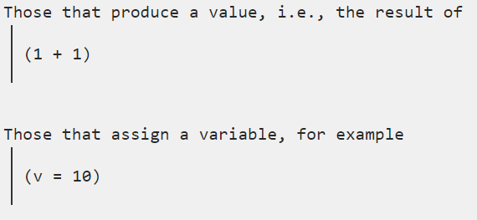
Expressions
An expression produces a result, or value, when it is evaluated.

Slide 5
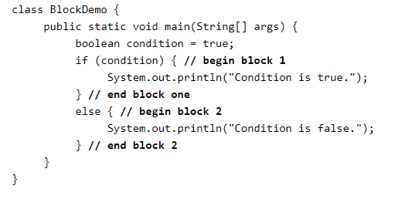
Some other types of statements
Block:
A block is a group of zero or more statements between balanced braces.

Slide 6
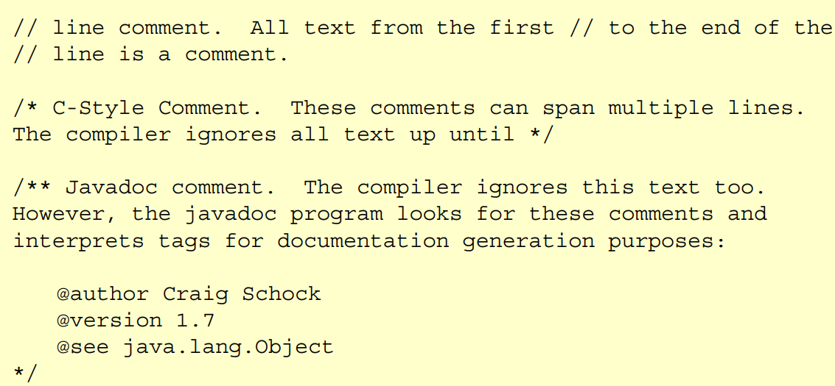
Some other types of statements
Comment:
Comments are discarded during compilation. They are used for documenting the code. There are three types of comments in java:
Single – line comments.
Multi – line comments.
Documentation comments.

Slide 7
Data types
Java is statically typed and also a strongly typed language. It means, all variables must be declared before its use. That is why we need to declare variable's type and name.
Data types are divided into two groups:
Primitive data types - includes byte, short, int, long, float, double, boolean and char.
Non-primitive data types - such as String, Arrays and Classes.

Slide 8
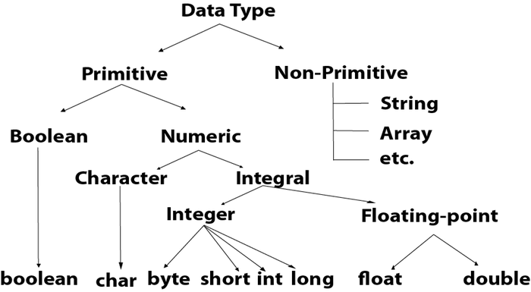
Data types

Slide 9
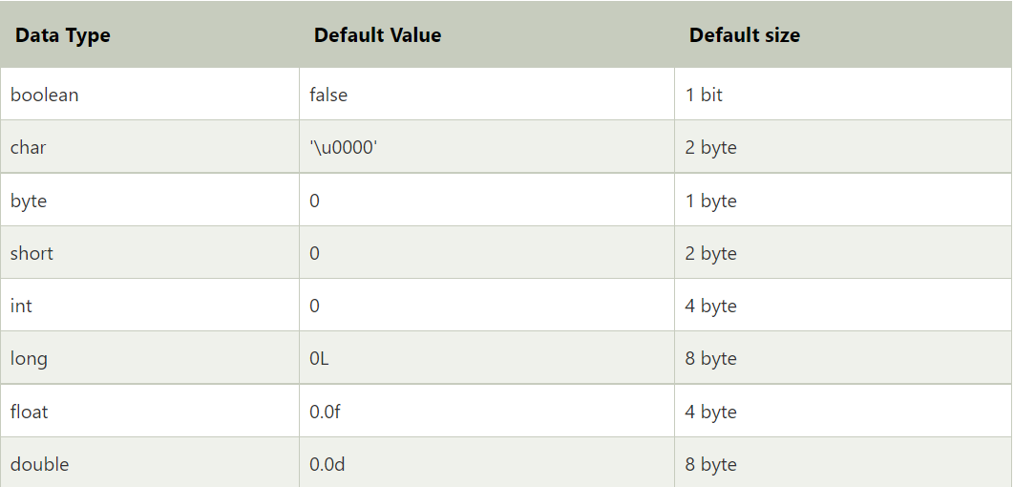
Primitive data types
A primitive data type specifies the size and type of variable values, and it has no additional methods.

Slide 10
Primitive data types
A primitive data type specifies the size and type of variable values, and it has no additional methods.
All numeric types are signed, there is no unsigned types in java.
2 types based on floating point value: float and double. Floating point numbers are not accurate, they are approximation. Float store 7 significant digits, double stores 15.
The character type defines a single character. In java it is 16-bits. Stores in Unicode format. Characters can be converted to integers to perform mathematical functions on them.

Slide 11
Non-Primitive or Reference Data Types
The Reference Data Types will contain a memory address of variable value because the reference types won’t store the variable value directly in memory. They are strings, objects, arrays, etc.

Slide 12
Variables
Variable in Java is a data container that stores the data values during Java program execution.
Every variable is assigned data type which designates the type and quantity of value it can hold. Variable is a memory location name of the data.
The Java variables have mainly three types : Local, Instance and Static.

Slide 13
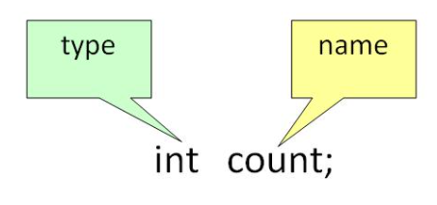
Variable Declaration
To declare a variable, you must specify the data type & give the variable a unique name.

Slide 14
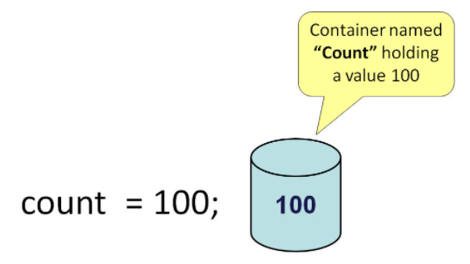
Variable Initialization
To initialize a variable, you must assign it a valid value.

Slide 15
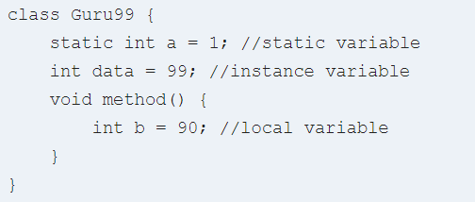
Types of variables
Local Variables
Local Variables are a variable that are declared inside the body of a method.
Instance Variables
Instance variables are defined without the STATIC keyword. They are defined Outside a method declaration. They are Object specific and are known as instance variables.
Static Variables
Static variables are initialized only once, at the start of the program execution. These variables should be initialized first, before the initialization of any instance variables.

Slide 16
Variable naming conventions
Java variable names are case sensitive. The variable name money is not the same as Money or MONEY.
Java variable names must start with a letter, or the $ or _ character.
After the first character in a Java variable name, the name can also contain numbers (in addition to letters, the $, and the _ character).
Variable names cannot be equal to reserved key words in Java. For instance, the words int or for are reserved words in Java. Therefore you cannot name your variables int or for.

Slide 17
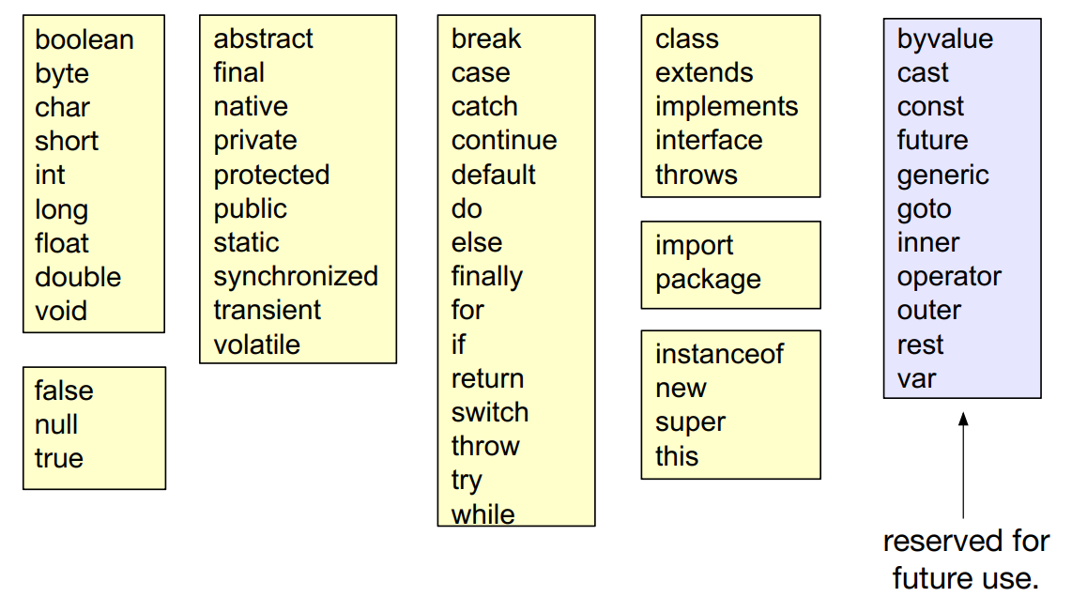
Reserved words

Slide 18
Good variable names
Use naming convention.
Use meaningful names.
Avoid using _ and $.
Start class name with Upper case letter. Variables and other identifiers with lower case letters.
Separate words with capital letters not with underscores.
myAccount, aLongVariableName

Slide 19
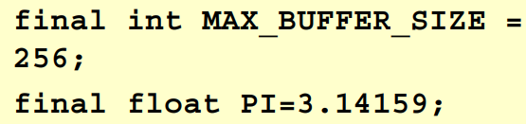
Constant values
A variable can be made constant by including “final” keyword.
Convention is: the names of variables declared as final are UPPER CASE.
Must be initialized upon declaration.

Slide 20
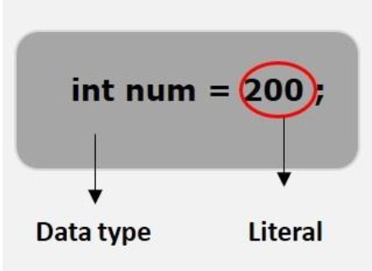
Literals
A literal is a source code representation of a fixed value. They are represented directly in the code without any computation.

Slide 21
Literals
Literals in Java can be classified into six types, as below:
Integral Literals
Floating-point Literals
Char Literals
String Literals
Boolean Literals
Null Literals

Slide 22
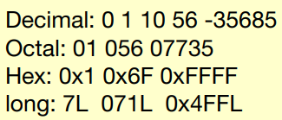
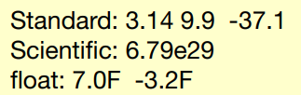
Literals
Integral literals can be specified in decimal, octal or hexadecimal. Integrals can be long or int. By default, they are int.
Floating point numbers can be defined using standard or scientific notation.
double by default
F indicates float
Single characters are defined within single quotes
can be defined as unicode
can be "special" character (eg. '\n’)
Strings are defined by double quotes
Strings are defined by double quotes
“This is a string”

Slide 23
Special characters
The following list shows these special characters; note that each is preceded by a backslash (\).
Special characters | Display
\' | Single quotation mark
\" | Double quotation mark
\\ | Backslash
\t | Tab
\b | Backspace
\r | Carriage return
\f | Formfeed
\n | Newline

Slide 24
Operators
Operator in Java is a symbol that is used to perform operations. For example: +, -, *, / etc.
Operators are defined by symbols:
Arithmetic (+, -, *, /, %)
Assignment (=, +=, -=, *=, /=)
Increment and decrement (++, --)
relational operators (==, !=, <, <=, >, >=)
logical operators (||, &&) (note: logical or, logical and)

Slide 25
Operator Precedence
Category | Operator | Associativity
Postfix | expression++ expression-- | Left to right
Unary | ++expression –-expression +expression –expression ~ ! | Right to left
Multiplicative | * / % | Left to right
Additive | + - | Left to right
Shift | << >> >>> | Left to right
Relational | < > <= >= instanceof | Left to right
Equality | == != | Left to right
Bitwise AND | & | Left to right
Bitwise XOR | ^ | Left to right
Bitwise OR | | | Left to right
Logical AND | && | Left to right
Logical OR | || | Left to right
Conditional | ?: | Right to left
Assignment | = += -= *= /= %= ^= |= <<= >>= >>>= | Right to left
Two operators of the same precedence will be evaluated based on their associativity

Slide 26
Java type conversion
When you assign a value of one data type to another, the two types might not be compatible with each other. If the data types are compatible, then Java will perform the conversion automatically known as Automatic Type Conversion.
If not, then they need to be cast or converted explicitly. For example, assigning an int value to a long variable.

Slide 27
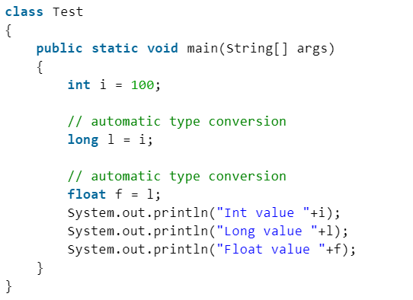
Widening or Automatic Type Conversion
Widening conversion takes place when two data types are automatically converted. This happens when:
The two data types are compatible.
When we assign a value of a smaller data type to a bigger data type.

Slide 28
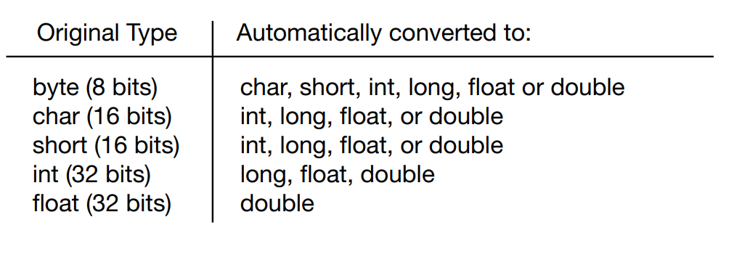
Widening or Automatic Type Conversion
In java, the numeric data types are compatible with each other, but no automatic conversion is supported from numeric type to char or boolean. Also, char and boolean are not compatible with each other.

Slide 29
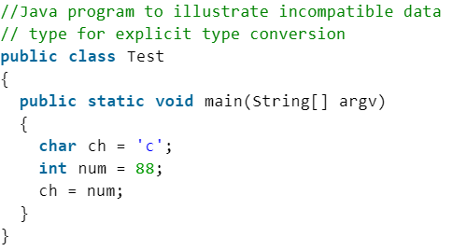
Narrowing or Explicit Conversion
If we want to assign a value of a larger data type to a smaller data type we perform explicit type casting or narrowing.
This is useful for incompatible data types where automatic conversion cannot be done.
Here, target type specifies the desired type to convert the specified value to.

Slide 30
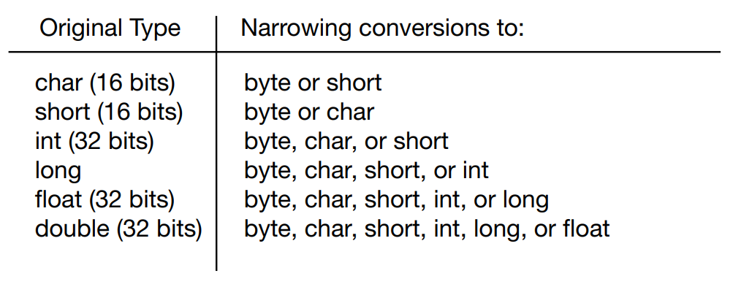
Narrowing or Explicit Conversion

Slide 31
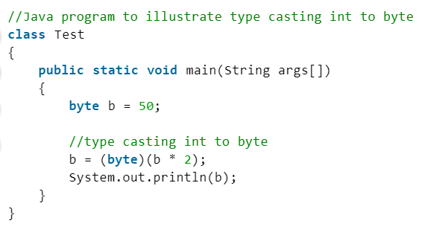

Casting
While evaluating expressions, the result is automatically updated to a larger data type of the operand. But if we store that result in any smaller data type it generates compile time error, due to which we need to typecast the result.

Slide 32
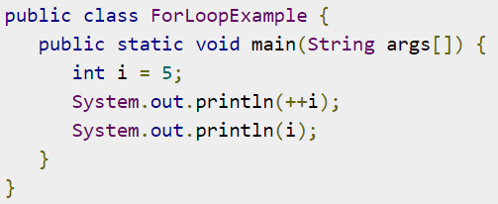
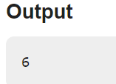


Postfix vs Prefix Notation
Java provides two operators (increment and decrement operators) namely ++ and --, to increment and decrement values by 1 respectively.
In Prefix, it first decrement/increment, the perform specified operation.

Slide 33
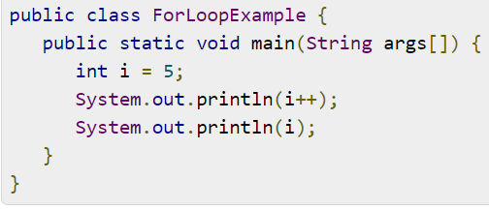
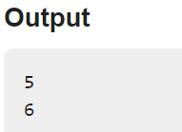
Postfix vs Prefix Notation
In postfix, it first performs specified operation then increment/decrement the value.

Slide 34
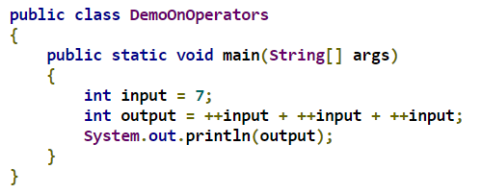
Exercise
What will be printed?
Notes:
27

Slide 35
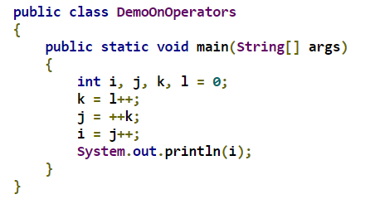
Exercise
What will be printed?
Notes:
1

